Slide 1
PA Compression Test User Guide
Nick Lalic
VNA Software Developer
Rohde & Schwarz North America
March 30th, 2016

Slide 2
REMOVE
Schematic
Port1
Port2
S1
a1
b1
b2
a2
S2
P_{in}
P_{out}
Driver
DUT S(f, P_{in})
Calibration Planes
Power Cal. Plane

Slide 3
Physical Setup
Example physical setup
Actual setup may vary with measurement needs (power level, pulsed RF, etc)
Port1
Port2
S1
a1
b1
b2
a2
S2
Driver
DUT S(f, P_{in})

Slide 4
Calibration
S-Parameter Calibration
For full two-port S-Parameters:
UOSM
TOSM
Any other full calibration
Port1
Port2
S1
a1
b1
b2
a2
S2
Driver
DUT S(f, P_{in})
Calibration Planes

Slide 5
Calibration
S-Parameter Calibration
For S11, S21 only:
One Path Two Port calibration
Port1
Port2
S1
a1
b1
b2
a2
S2
Driver
DUT S(f, P_{in})
Calibration Planes

Slide 6
Calibration
Power Calibration
Standard Power cal of Port 1 source (S₁), reference receiver (a₁)
Measure P_{in} (a₁) along with S-Parameters
Calculate compression point, P_{out} from P_{in} and S₂₁
No need to power calibrate Port 1 measurement receiver (b₁) or Port 2
Port1
Port2
S1
a1
b1
b2
a2
S2
Driver
DUT S(f, P_{in})
Power Cal. Plane
P_{in}
P_{out} = P_{in} + S₂₁

Slide 7
Measurement
Because the measured power (P_{In}, a₁) is being used, the measurement points vs power do not have to (and in general will not) perfectly line up on a grid.
Compression is calculated using measured S-Parameters, P_{In}
Note: Because of limitations of the VNA, traces may be re-interpolated onto a linearly spaced x-axis as necessary. Raw data (Export) is not effected.
Gain
Pin

Slide 8
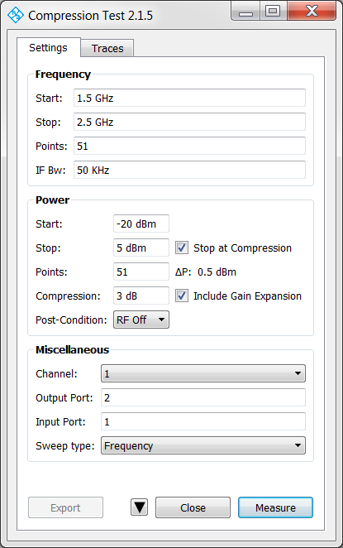
Graphical User Interface
Settings tab
Frequency settings
Power settings
Toggle Mini GUI mode
Exit application
Miscellaneous settings
Start Measurement
Export results to file (Touchstone, CSV)

Slide 9
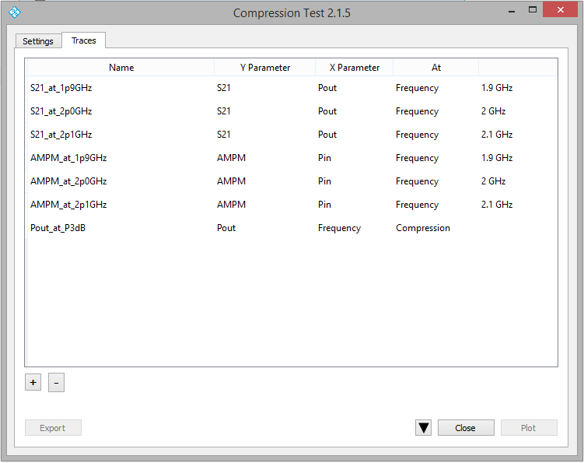
Graphical User Interface
Traces tab
Trace list
Toggle
Mini GUI
mode
Exit
Add/Remove
Trace
Write traces
to VNA
Export results to file (Touchstone, CSV)

Slide 10

Mini Graphical User Interface
Toggle Mini-GUI
Measure and plot traces
Export results (Touchstone, CSV)
Exit

Slide 11
Settings
Frequency Settings
Start Frequency
Stop Frequency
Points
IF Bandwidth
Frequency settings are strictly obeyed

Slide 12
Settings
Power Settings
Start Power
Stop Power
Points
Compression level (typically 1-3 dB)
Stop at Compression: Stops increasing measurement power level at or just after compression is achieved. DUT is driven at most ΔP over compression
Note: Since the compression point of most PAs varies vs frequency, Stop at compression will result in a different number of power measurement points per each frequency (ie the resulting matrix will not be “square”)

Slide 13
Settings
Power Settings
Include Gain Expansion: When unchecked, the gain at the lowest power level is used for each frequency. For PAs that include gain expansion (gain can increase as power increases), this option finds the power level of maximum gain, and uses that gain value to find compression.

Slide 14
Settings
Power Settings
Post-Condition
RF Off: Stops all sweeps and turns power off between sweeps after measurements end
None: Does nothing after measurements end

Slide 15
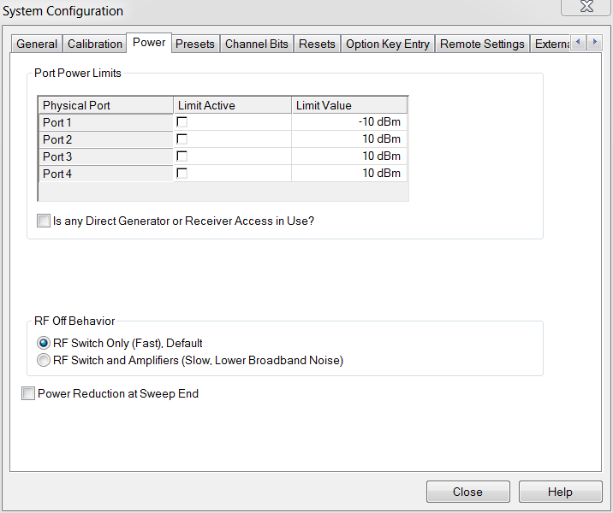
Settings
Power Settings
Note: The RF Off post condition uses a setting called “Reduce RF Power between sweeps”. This setting persists through instrument preset. To put the instrument back in it’s factory default state (power on at last measurement point between sweeps), the setting can be found at: System Config (hard key) -> System Config (soft key) -> Power (tab) -> Uncheck “Power Reduction at Sweep End”

Slide 16
Settings
Miscellaneous Settings
(Reference) Channel:
Settings outside the scope of PA Compression Test should be set in a reference channel before measurement
These settings are used for the measurement
Settings taken from reference channel:
User defined ports
Pulsed RF power
Calibration
Power calibration
… Anything not explicitly overwritten in Settings

Slide 17
Settings
Miscellaneous Settings
Output Port, Input Port
Sweep Type:
Frequency
A segmented frequency sweep is performed for a fixed power level. The power level is increased with each sweep.
When Stop at Compression is selected, frequencies that have reached compression are removed from subsequent segmented frequency sweeps.
Power
For a fixed frequency, a power sweep is performed per Power Settings

Slide 18
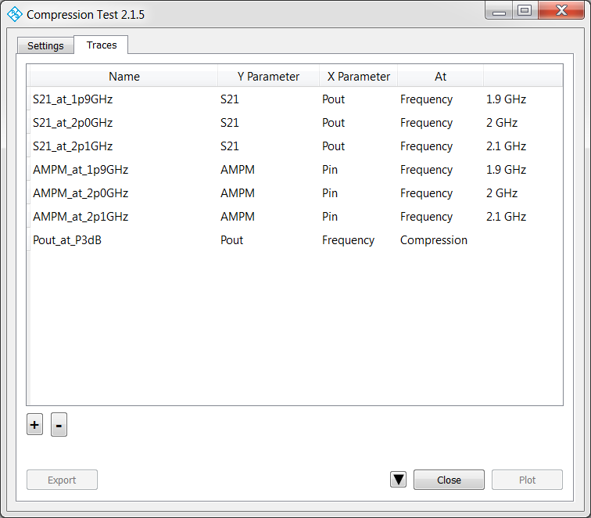
Traces
Trace Options
Y:
S11, S21, S12, S22
AM-PM Conversion
Pin
Pout
X:
Frequency
Pin
Pout
At:
Compression
Max. Gain
Frequency value
Power value

Slide 19
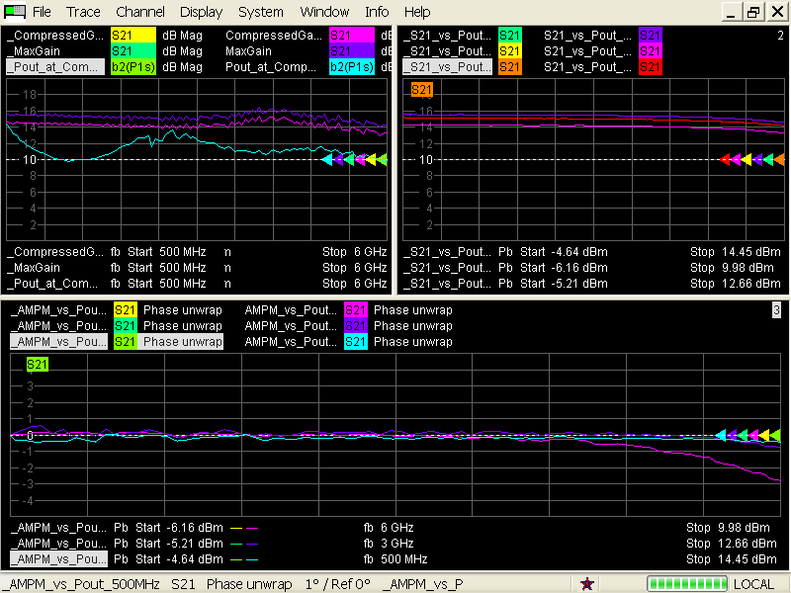
Traces
Initially, traces are created in new diagram(s) on the VNA
User then configures each trace (diagram, format, markers etc)
Subsequent replotting will update trace values without disturbing customization.

Slide 20
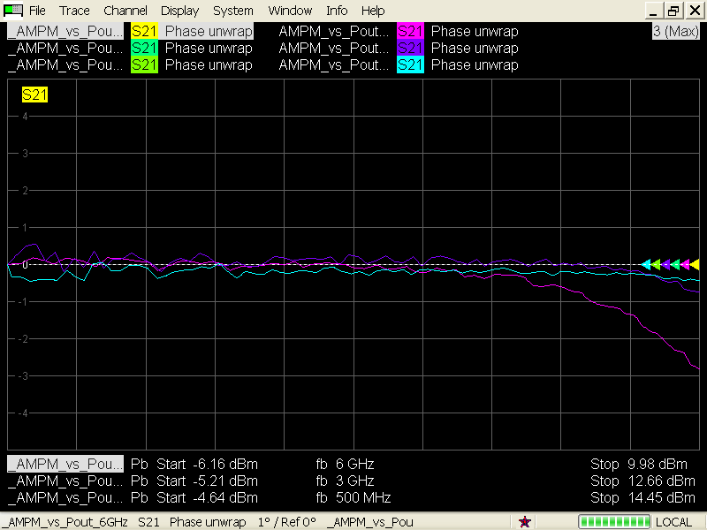
Traces
Note: For the purposes of this application, AMPM is defined as: AMPM = unwrapped_phase(S21) – unwrapped_phase(S21[P_{Low}])
AMPM can be plotted versus various x-axis
Example: AMPM vs P_{Out} @ 500 MHz, 3 GHz and 6 GHz

Slide 21
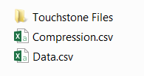
Export
Results are exported into a ZIP file
Results are exported in two formats:
Touchstone 1.0 files – One per power level
Compression CSV – Summary of compression point results
Raw Data CSV file – containing all raw measurement points

Slide 22
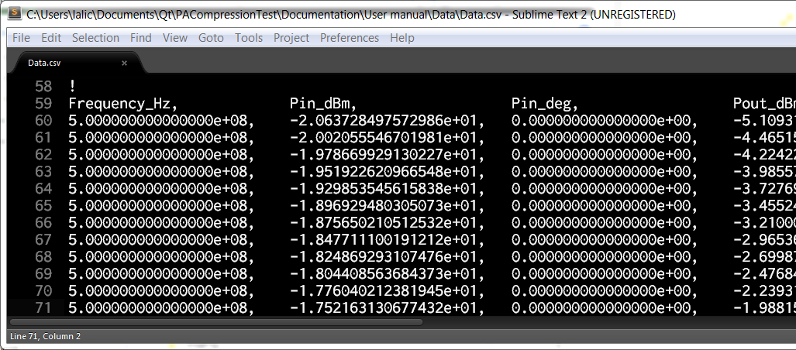
Export
CSV Format
Header
VNA info
Settings (Frequency, Power, Miscellaneous)
RF Pulse info (if applicable)
Data Columns:
Frequency
Pin (dBm, deg)
Pout (dBm, deg)
AMPM (deg)
S₁₁, S₁₂, S₂₁, S₂₂ (dB, deg)

Slide 23
Contact
Please contact me with questions or comments
Nick Lalic VNA Software Developer
San Francisco, CA
+1 (424) 200-2846 nick.lalic@rsa.rohde-schwarz.com
http://vna.rs-us.net

